Slide 1

REBAR: Retrieval-based Reconstruction for Time-series Contrastive Learning
Maxwell A. Xu¹, Alexander Moreno¹, Hui Wei³, Benjamin M. Marlin³, James M. Rehg²
¹Georgia Institute of Technology, ²University of Illinois Urbana-Champaign ³University of Massachusetts Amherst
Maxwell A. Xu¹, Alexander Moreno², Supriya Nagesh¹, V. Burak Aydemir¹, David W. Wetter³, Santosh Kumar⁴, James M. Rehg¹
¹Georgia Institute of Technology, ²Luminous Computing, ³University of Utah, ⁴University of Memphis
Presented at ICLR 2024
Notes:
Hello, My name is Maxwell Xu, and I will be presenting our work on REBAR, a novel method for identifying positive pairs in time-series contrastive learning with retrieval-based reconstruction.

Slide 2
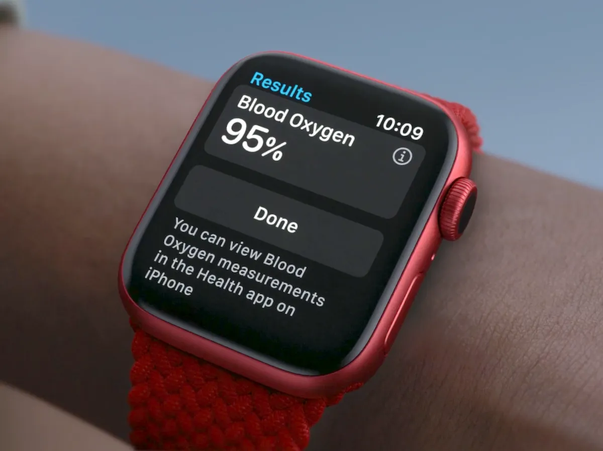
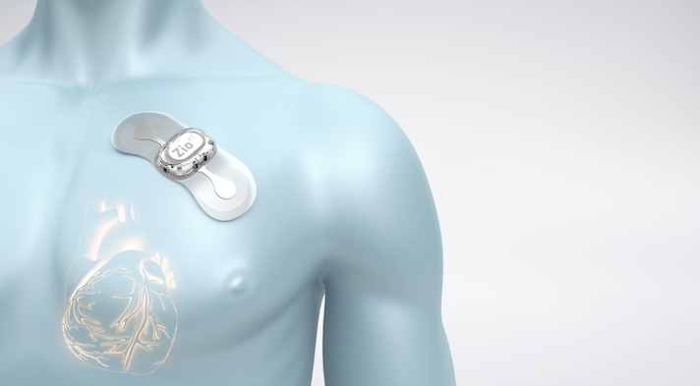
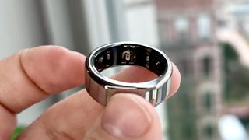
Self-supervised Contrastive Learning
Advances in wearable sensors technology → Large volumes of unlabeled health time-series signals
Oura Ring [1]
Zio ECG Monitor [3]
Apple Watch [2]
[1] https://ouraring.com/
[2] https://www.apple.com/watch/
[3] https://www.irhythmtech.com/providers/zio-service/zio-monitors
Notes:
Due to advances in health sensor technology, it is increasingly feasible to capture a large volume of health-related time-series data, but unfortunately, the cost of labeling this data remains high.

Slide 3
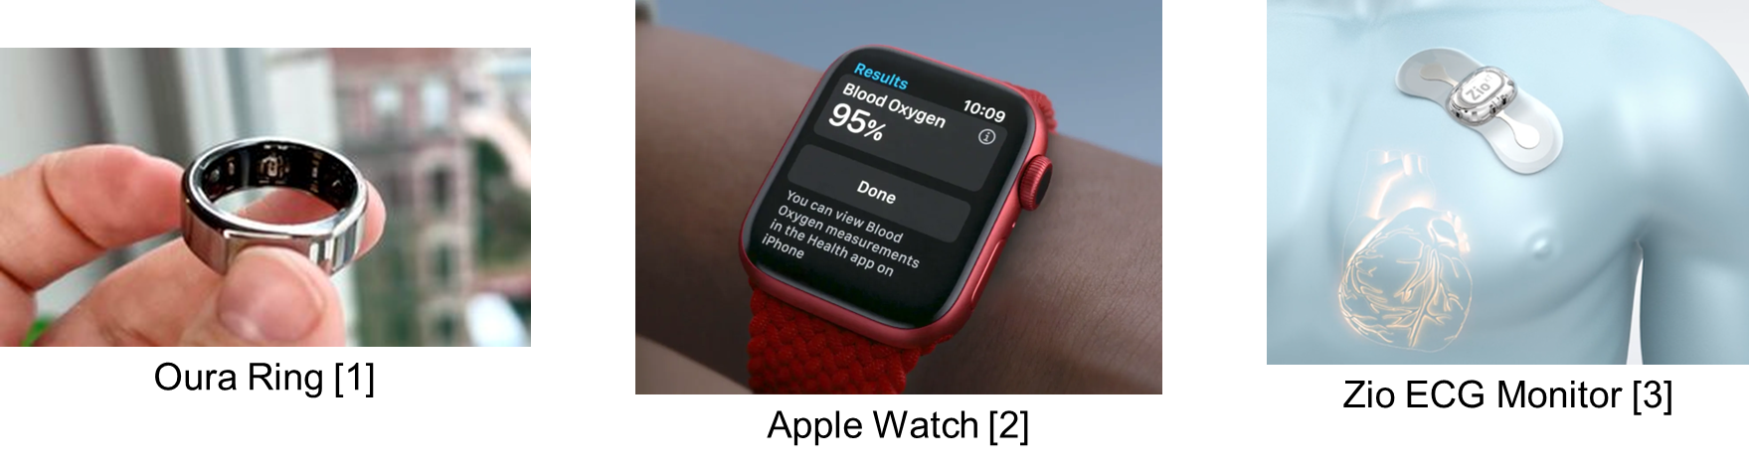
Self-supervised Contrastive Learning
Advances in wearable sensors technology → Large volumes of unlabeled health time-series signals
Contrastive learning is a strong self-supervised learning method, but identifying positive pairs is non-trivial
The positive pairs must be similar enough to share semantic meaning but different enough to capture within-class variation
Positive
Anchor
Negatives
Contrastive Learning Approach
[1] https://ouraring.com/
[2] https://www.apple.com/watch/
[3] https://www.irhythmtech.com/providers/zio-service/zio-monitors
Notes:
This presents a strong opportunity for self-supervised learning techniques, such as contrastive learning. But how can we identify meaningful positive pairs, without labels Such that they share semantic meaning but capture within-class variation.

Slide 4
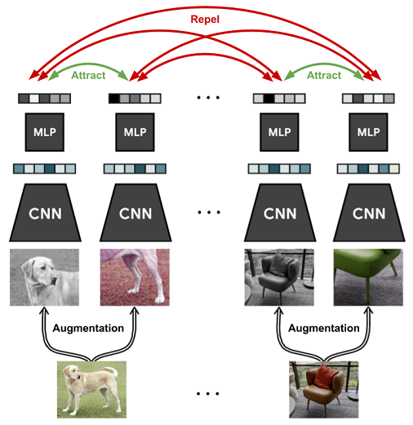
Positive Pairs in Prior Work
Augmentation-based Approaches
Originate from vision domain
Inconsistent set of augmentations in time-series approaches
TF-C [2] uses jittering+scaling while TS2Vec [3] explicitly excludes them
Sampling-based Approaches
Identify positive pairs from as subsequences within a longer time-series
Typically, naively uses temporal proximity to identify positive pairs (e.g. TNC [4], T-loss [5])
SimCLR [1] Approach
[1] Chen et al., 2020. A Simple Framework for Contrastive Learning of Visual Representations. ICML 2020.
[2] Zhang et al., 2022. Self-Supervised Contrastive Pre-Training For Time Series via Time-Frequency Consistency. NeurIPS 2022.
[3] Yue et al., 2022. TS2Vec: Towards Universal Representation of Time Series. AAAI 2022.
[4] Tonekaboni et al., 2021. Unsupervised Representation Learning for Time Series with Temporal Neighborhood Coding. ICLR 2021.
[5] Franceschi et al., 2019. Unsupervised Scalable Representation Learning for Multivariate Time Series. NeurIPS 2019.
Notes:
If we look at prior work in the time-series contrastive learning space, there are two main approaches. The first of which are augmentation-based approaches, which originate from the vision domain..

Slide 5
Positive Pairs in Prior Work
Augmentation-based Approaches
Originate from vision domain
Inconsistent set of augmentations in time-series approaches
TF-C [2] uses jittering+scaling while TS2Vec [3] explicitly excludes them
Sampling-based Approaches
Identify positive pairs from as subsequences within a longer time-series
Typically, naively uses temporal proximity to identify positive pairs (e.g. TNC [4], T-loss [5])
SimCLR [1] Approach
[1] Chen et al., 2020. A Simple Framework for Contrastive Learning of Visual Representations. ICML 2020.
[2] Zhang et al., 2022. Self-Supervised Contrastive Pre-Training For Time Series via Time-Frequency Consistency. NeurIPS 2022.
[3] Yue et al., 2022. TS2Vec: Towards Universal Representation of Time Series. AAAI 2022.
[4] Tonekaboni et al., 2021. Unsupervised Representation Learning for Time Series with Temporal Neighborhood Coding. ICLR 2021.
[5] Franceschi et al., 2019. Unsupervised Scalable Representation Learning for Multivariate Time Series. NeurIPS 2019.
Notes:
In such approaches, the positive pair is formed via augmentations of the original instance.

Slide 6
Positive Pairs in Prior Work
Augmentation-based Approaches
Originate from vision domain
Inconsistent set of augmentations in time-series approaches
TF-C [2] uses jittering+scaling while TS2Vec [3] explicitly excludes them
Sampling-based Approaches
Identify positive pairs from as subsequences within a longer time-series
Typically, naively uses temporal proximity to identify positive pairs (e.g. TNC [4], T-loss [5])
SimCLR [1] Approach
[1] Chen et al., 2020. A Simple Framework for Contrastive Learning of Visual Representations. ICML 2020.
[2] Zhang et al., 2022. Self-Supervised Contrastive Pre-Training For Time Series via Time-Frequency Consistency. NeurIPS 2022.
[3] Yue et al., 2022. TS2Vec: Towards Universal Representation of Time Series. AAAI 2022.
[4] Tonekaboni et al., 2021. Unsupervised Representation Learning for Time Series with Temporal Neighborhood Coding. ICLR 2021.
[5] Franceschi et al., 2019. Unsupervised Scalable Representation Learning for Multivariate Time Series. NeurIPS 2019.
Notes:
However, unlike time-series, cameras have a much better established set of invariances to exploit, and such time-series methods often use an inconsistent set of augmentations

Slide 7
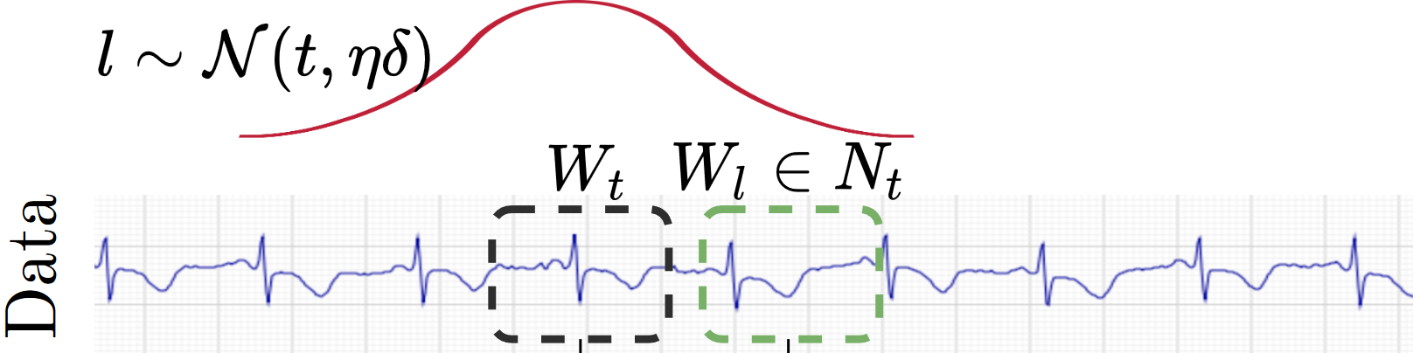
Positive Pairs in Prior Work
Augmentation-based Approaches
Originate from vision domain
Inconsistent set of augmentations in time-series approaches
TF-C [2] uses jittering+scaling while TS2Vec [3] explicitly excludes them
Sampling-based Approaches
Identify positive pairs from as subsequences within a longer time-series
Typically, naively uses temporal proximity to identify positive pairs (e.g. TNC [4], T-loss [5])
SimCLR [1] Approach
TNC [4] Approach
[1] Chen et al., 2020. A Simple Framework for Contrastive Learning of Visual Representations. ICML 2020.
[2] Zhang et al., 2022. Self-Supervised Contrastive Pre-Training For Time Series via Time-Frequency Consistency. NeurIPS 2022.
[3] Yue et al., 2022. TS2Vec: Towards Universal Representation of Time Series. AAAI 2022.
[4] Tonekaboni et al., 2021. Unsupervised Representation Learning for Time Series with Temporal Neighborhood Coding. ICLR 2021.
[5] Franceschi et al., 2019. Unsupervised Scalable Representation Learning for Multivariate Time Series. NeurIPS 2019.
Notes:
The next idea for constructing positive pairs is a sampling-based approach. With this idea, we can identify positive pairs from sampled subsequences from a longer time-series. In the prior work, typically, these methods will only use nearby subsequences as positive instances.

Slide 8
Positive Pairs in Prior Work
Augmentation-based Approaches
Originate from vision domain
Inconsistent set of augmentations in time-series approaches
TF-C [2] uses jittering+scaling while TS2Vec [3] explicitly excludes them
Sampling-based Approaches
Identify positive pairs from as subsequences within a longer time-series
Typically, naively uses temporal proximity to identify positive pairs (e.g. TNC [4], T-loss [5])
SimCLR [1] Approach
TNC [4] Approach
[1] Chen et al., 2020. A Simple Framework for Contrastive Learning of Visual Representations. ICML 2020.
[2] Zhang et al., 2022. Self-Supervised Contrastive Pre-Training For Time Series via Time-Frequency Consistency. NeurIPS 2022.
[3] Yue et al., 2022. TS2Vec: Towards Universal Representation of Time Series. AAAI 2022.
[4] Tonekaboni et al., 2021. Unsupervised Representation Learning for Time Series with Temporal Neighborhood Coding. ICLR 2021.
[5] Franceschi et al., 2019. Unsupervised Scalable Representation Learning for Multivariate Time Series. NeurIPS 2019.
Notes:
So for example, in temporal neighborhood coding, shown in the right, these two adjacent subsequences are the identified positive pairs.

Slide 9
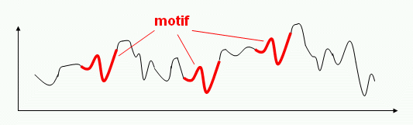
A quick aside: Time-series Motifs
Motifs: brief temporal shapes that repeat themselves approximately across the time-series
Typically, indicative of semantic properties, can be class discriminative
E.g. QRS complex in ECG, Hand swinging motion in HAR, Dicrotic notch in PPG
Key idea: If two sequences share similar motifs, then they are a good candidate to form positive pairs
Motifs present in Time-series
Notes:
We propose new method to identify positive pairs from sampled subsequences based on the idea of motifs. time-series motifs are brief temporal shapes that typically capture semantic and class-discriminative information.
Therefore, if two subsequences share similar motifs, then they would be a good candidate to form positive pairs

Slide 10
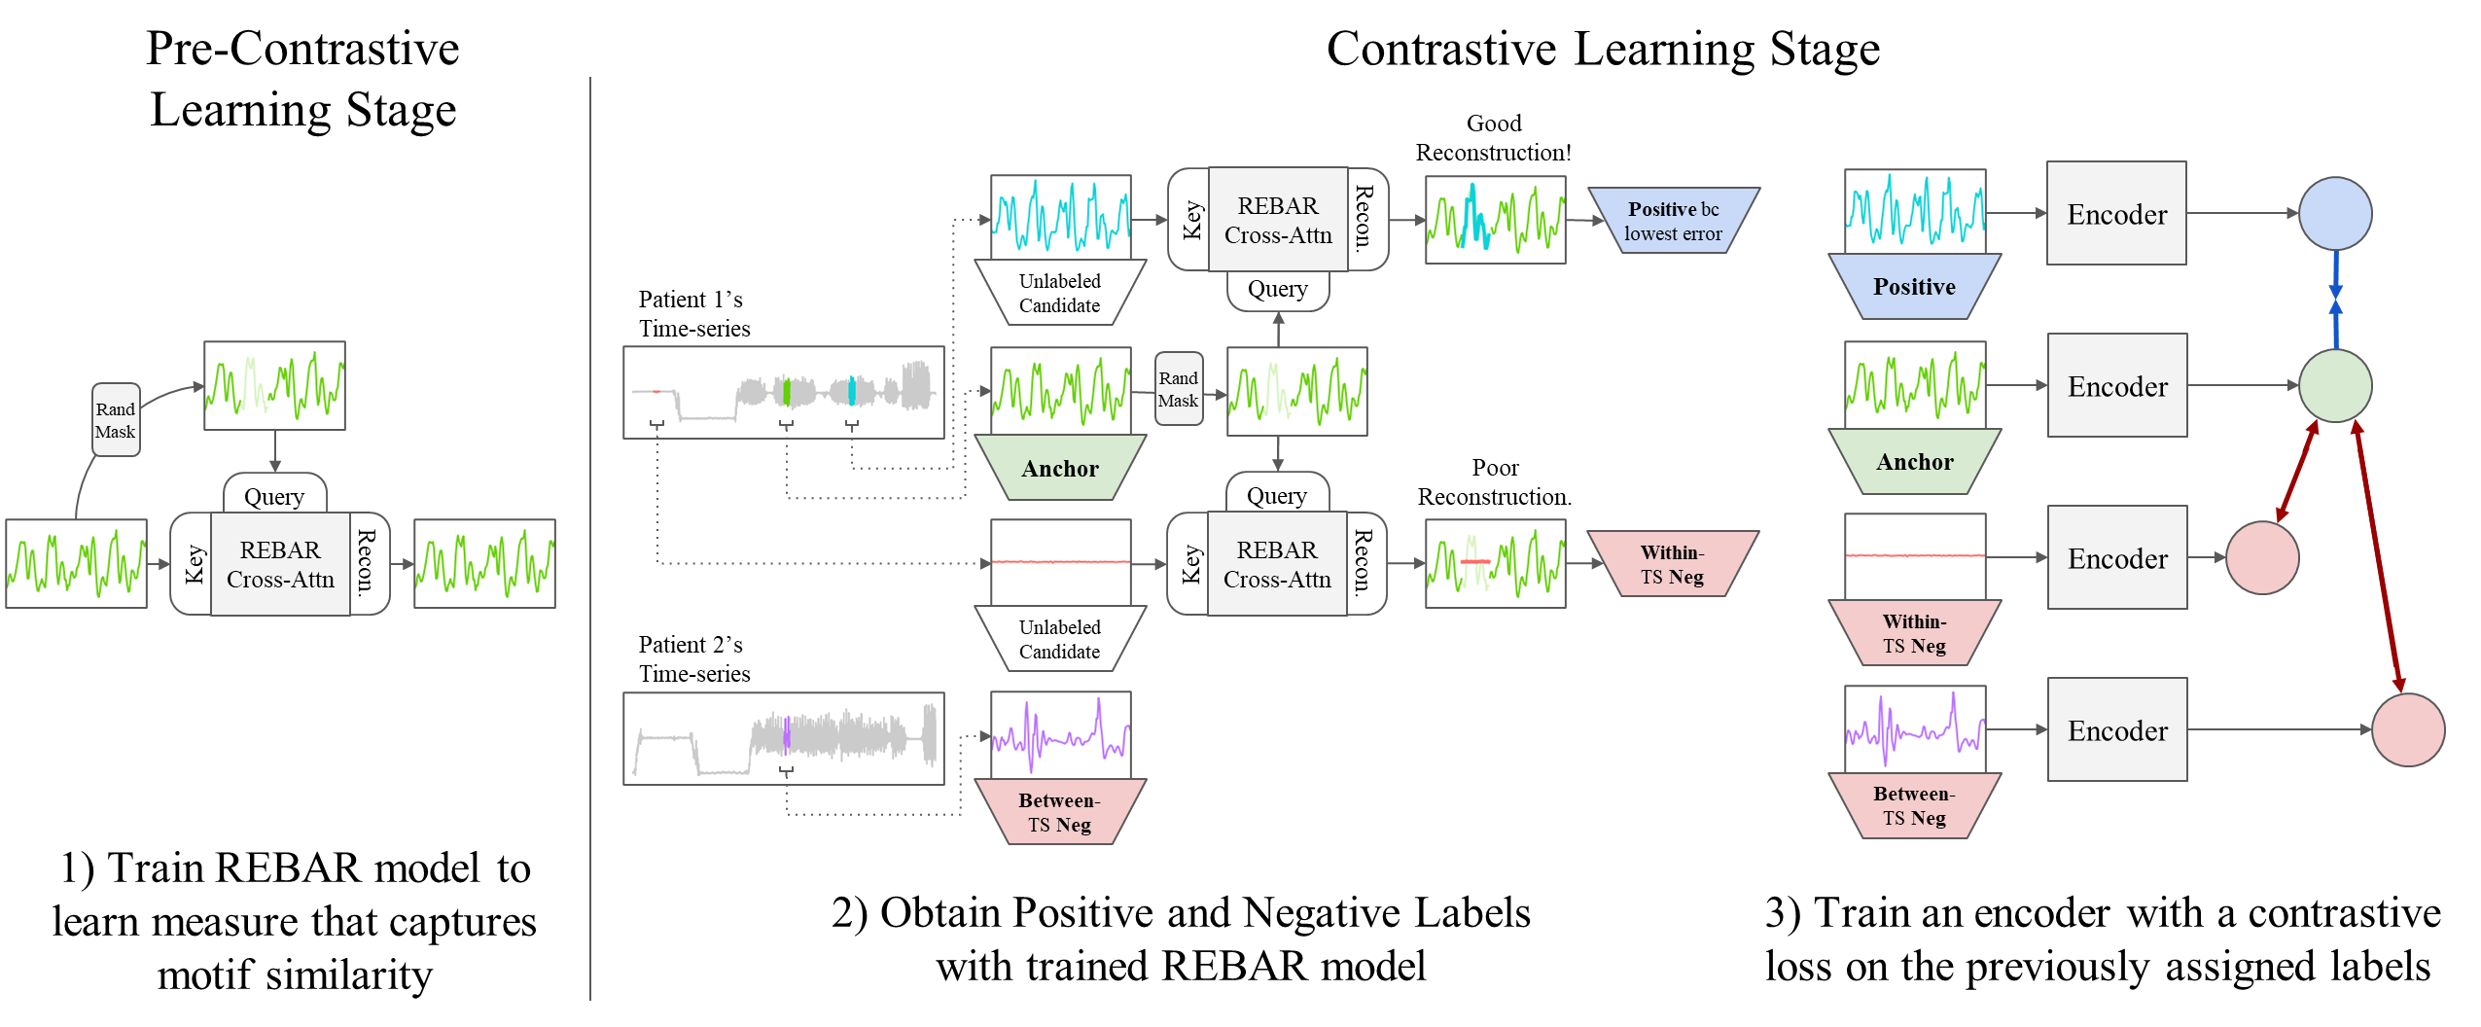
REBAR Contrastive Learning Approach
Notes:
This is the full REBAR approach

Slide 11
REBAR in Pre-Contrastive Learning Stage
Notes:
nd first we focus on the pre-contrastive learning stage, where we construct the REBAR measure that captures motif- similarity

Slide 12
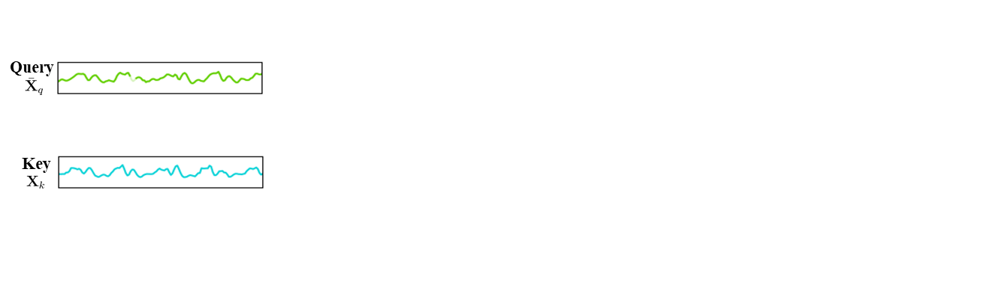
Design of REBAR Cross-Attention Model
Goal: The retrieval-based reconstruction error should be class-discriminative, such that pairs with better reconstruction are more likely to be semantically related.
Notes:
While designing our REBAR cross-attention, we keep in mind our goal that the reconstruction error should be class-discriminative measure, such that pairs with better reconstruction are more likely to be semantically related, which helps guide our positive pair selection
So first lets take these two sequences. our masked out query and our key.

Slide 13
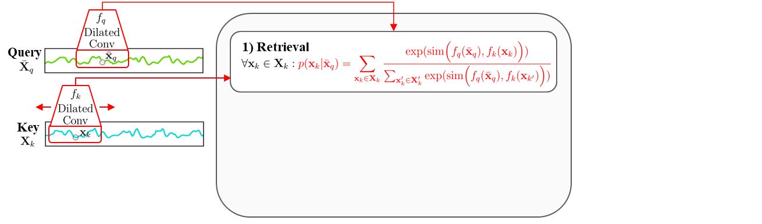
Design of REBAR Cross-Attention Model
Goal: The retrieval-based reconstruction error should be class-discriminative, such that pairs with better reconstruction are more likely to be semantically related.
1) Retrieval Step
The retrieval function identifies time points in the key useful for reconstructing based on the motif similarity.
REBAR Cross-Attention reconstruction of a single masked-out point, ${\overline{x}}_{q}$
Notes:
In our REBAR cross-attention model, our first step is retrieval, in which the model identifies time points in the key useful for reconstructing our green query based on the motif similarity with our blue key.
In this step, our dilated convolution for the key scans throughout the key for a context window that best matches the context window around the masked out point in the query.

Slide 14
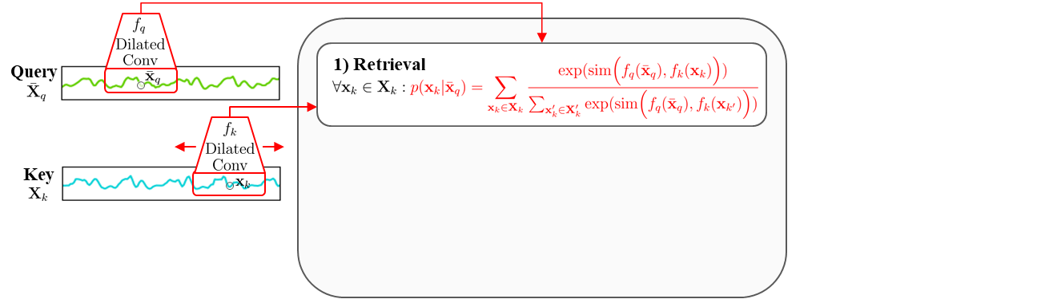
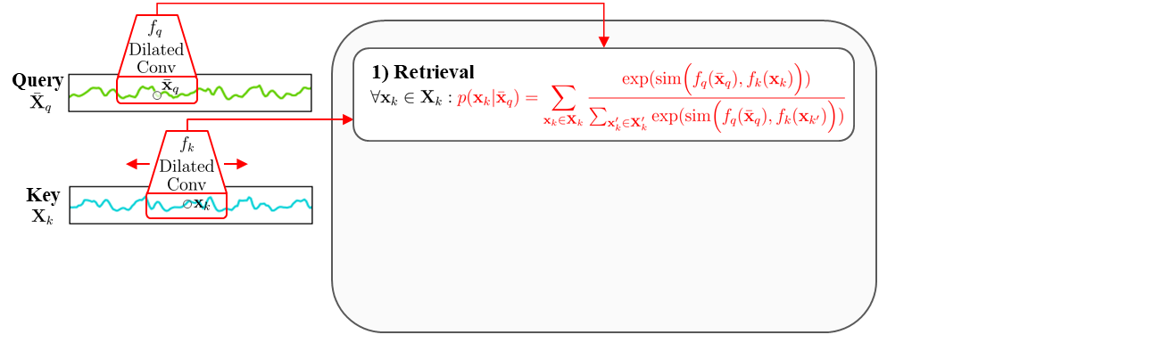
Design of REBAR Cross-Attention Model
Goal: The retrieval-based reconstruction error should be class-discriminative, such that pairs with better reconstruction are more likely to be semantically related.
1) Retrieval Step
The retrieval function identifies time points in the key useful for reconstructing based on the motif similarity.
REBAR Cross-Attention reconstruction of a single masked-out point, ${\overline{x}}_{q}$
Notes:
So here it is scanning

Slide 15
Design of REBAR Cross-Attention Model
Goal: The retrieval-based reconstruction error should be class-discriminative, such that pairs with better reconstruction are more likely to be semantically related.
1) Retrieval Step
The retrieval function identifies time points in the key useful for reconstructing based on the motif similarity.
REBAR Cross-Attention reconstruction of a single masked-out point, ${\overline{x}}_{q}$
Notes:
Scanning

Slide 16
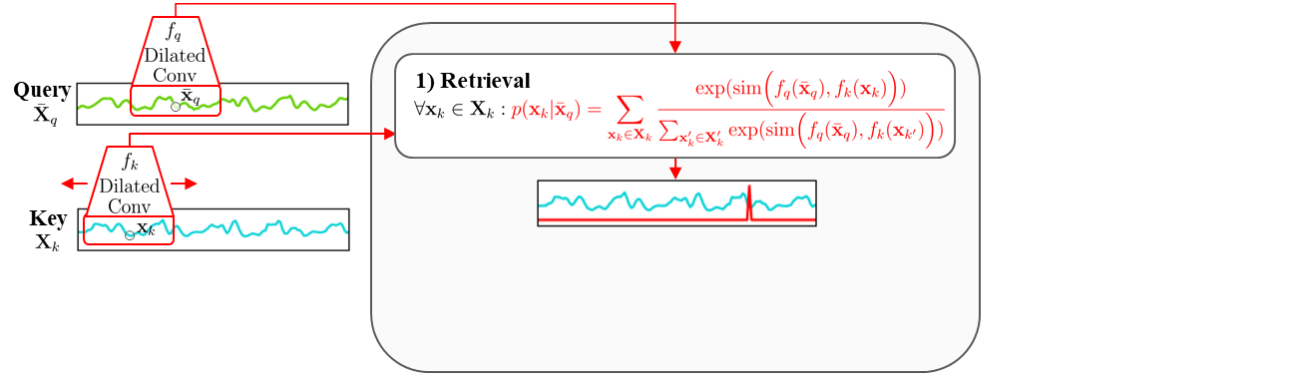
Design of REBAR Cross-Attention Model
Goal: The retrieval-based reconstruction error should be class-discriminative, such that pairs with better reconstruction are more likely to be semantically related.
1) Retrieval Step
The retrieval function identifies time points in the key useful for reconstructing based on the motif similarity.
This gives us an attention distribution over the key sequence
REBAR Cross-Attention reconstruction of a single masked-out point, ${\overline{x}}_{q}$
Notes:
And this gives us an attention distribution over the key subsequence based on the best match given the context window in the query

Slide 17
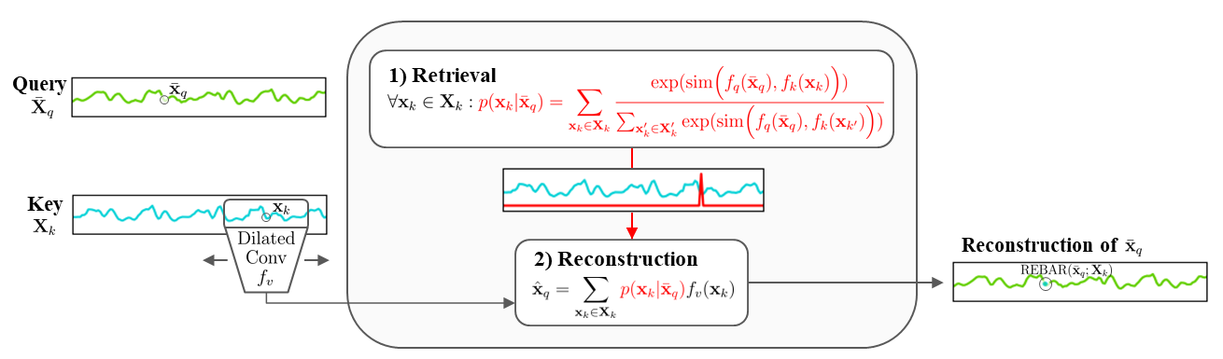
Design of REBAR Cross-Attention Model
Goal: The retrieval-based reconstruction error should be class-discriminative, such that pairs with better reconstruction are more likely to be semantically related.
2) Reconstruction Step
A weighted average of the retrieved regions is used to reconstruct the missing point.
REBAR Cross-Attention reconstruction of a single masked-out point, ${\overline{x}}_{q}$
Notes:
So we can then use this attention distribution to find the best regions in the key to be used to help reconstruct the query

Slide 18
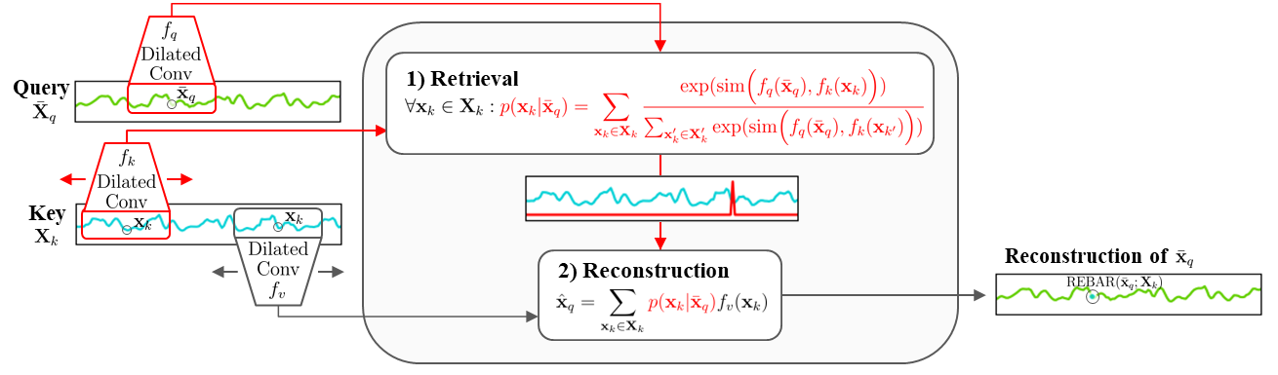
Design of REBAR Cross-Attention Model
The query is never directly used for reconstruction. Instead, reconstruction is directly dependent on the motif similarity between the query and key.
REBAR error directly captures semantic information, such that when the REBAR error is lower, the pair is more likely to share the same class
REBAR Cross-Attention reconstruction of a single masked-out point, ${\overline{x}}_{q}$
Notes:
And as such, the query is never directly used for reconstruction. Instead, reconstruction is directly dependent on the motif similarity between the query and key.
REBAR error directly captures semantic information, such that when the error is lower, the pair is more likely to share the same class

Slide 19
REBAR in Contrastive Learning Stage
Notes:
We can then use the REBAR reconstruction error to guide our positive pair selection for contrastive learning.

Slide 20
Applying REBAR to Contrastive Learning
Randomly sample a set of candidate and an anchor subsequences from a given time-series, then:
The one with the lowest REBAR error is positive.
All other candidates are within-time-series negatives.
Within-TS Loss
*Captures how a time-series evolves over time, e.g. how activity signals changes over time*
Notes:
As such, we first Randomly sample an anchor and a set of candidate subsequences from a given time-series.
The candidate that provided the lowest error in reconstructing the anchor is a positive and the rest are within-time-series negatives. We can then form a within-time-series loss, which helps model how a time-series can evolve over time.

Slide 21
Applying REBAR to Contrastive Learning
Randomly sample a set of candidate and an anchor subsequences from a given time-series, then:
The one with the lowest REBAR error is positive.
All other candidates are within-time-series negatives.
*Captures differences in individuals, e.g. how each patient has a unique physiologies resulting in different ECGs*
Within-TS Loss
Other subsequences from other time-series are
between-time-series negatives.
Between-TS Loss
Notes:
Next we can grab negatives from other time-series in our batch, and treat those as between-time-series negatives to construct our between-time-series loss, which helps model differences in individuals and patients

Slide 22
Applying REBAR to Contrastive Learning
Randomly sample a set of candidate and an anchor subsequences from a given time-series, then:
The one with the lowest REBAR error is positive.
Convex combination that can be tuned if desired.
All other candidates are within-time-series negatives.
Within-TS Loss
Combined Loss
Other subsequences from other time-series are
between-time-series negatives.
Between-TS Loss
Notes:
We then combine these for our final loss function to simultaneously model both phenomena. And now we can look at the downstream results of our REBAR method and compare them to other contrastive learning methods.

Slide 23
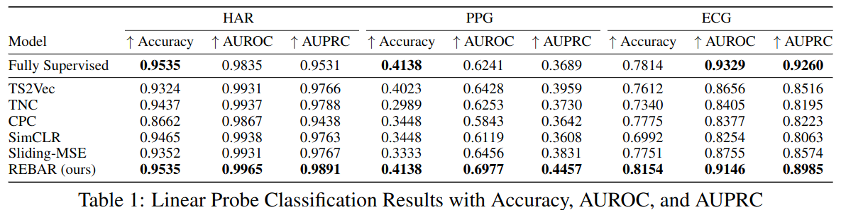
Downstream Linear Probe Results
REBAR consistently achieved the strongest results, beating a wide range of representative augmentation-based and sampling-based contrastive methods, even beating a fully-supervised approach.
Notes:
In our downstream evaluation, the model architecture constant across all methods, with the only difference between them being the different ways in which positive pairs are chosen. And with this, we see that REBAR consistently achieved the strongest results, beating a wide range of representative augmentation-based and sampling-based contrastive methods, even beating a fully-supervised approach.

Slide 24
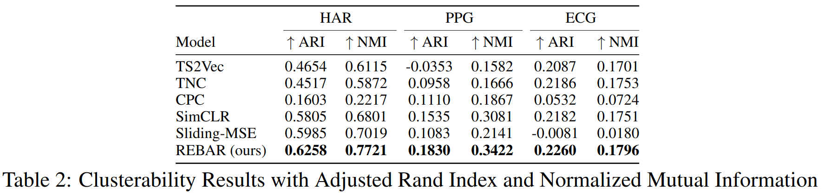
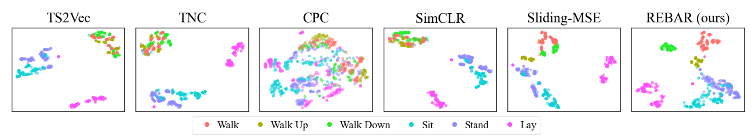
Downstream Clustering Results
Clusterability results demonstrate that REBAR has a strong agreement between k-mean clusters and true labels, corroborating classification results.
In the t-SNE visualization, unlike most methods, REBAR is able to distinguish between the walk, walk up, and walk down labels.
Notes:
WE follow this up with clusterability evaluations, and REBAR continues to have the strongest results. Very interestingly, we can see in our T-SNE visaualization, unlike most methods, REBAR is able to distnguish between semantically similar, but distinct classes,

Slide 25
Downstream Clustering Results
Clusterability results demonstrate that REBAR has a strong agreement between k-mean clusters and true labels, corroborating classification results.
In the t-SNE visualization, unlike most methods, REBAR is able to distinguish between the walk, walk up, and walk down labels.
Notes:
such as the Walking label, the Walking up label, and the walking down label.

Slide 26
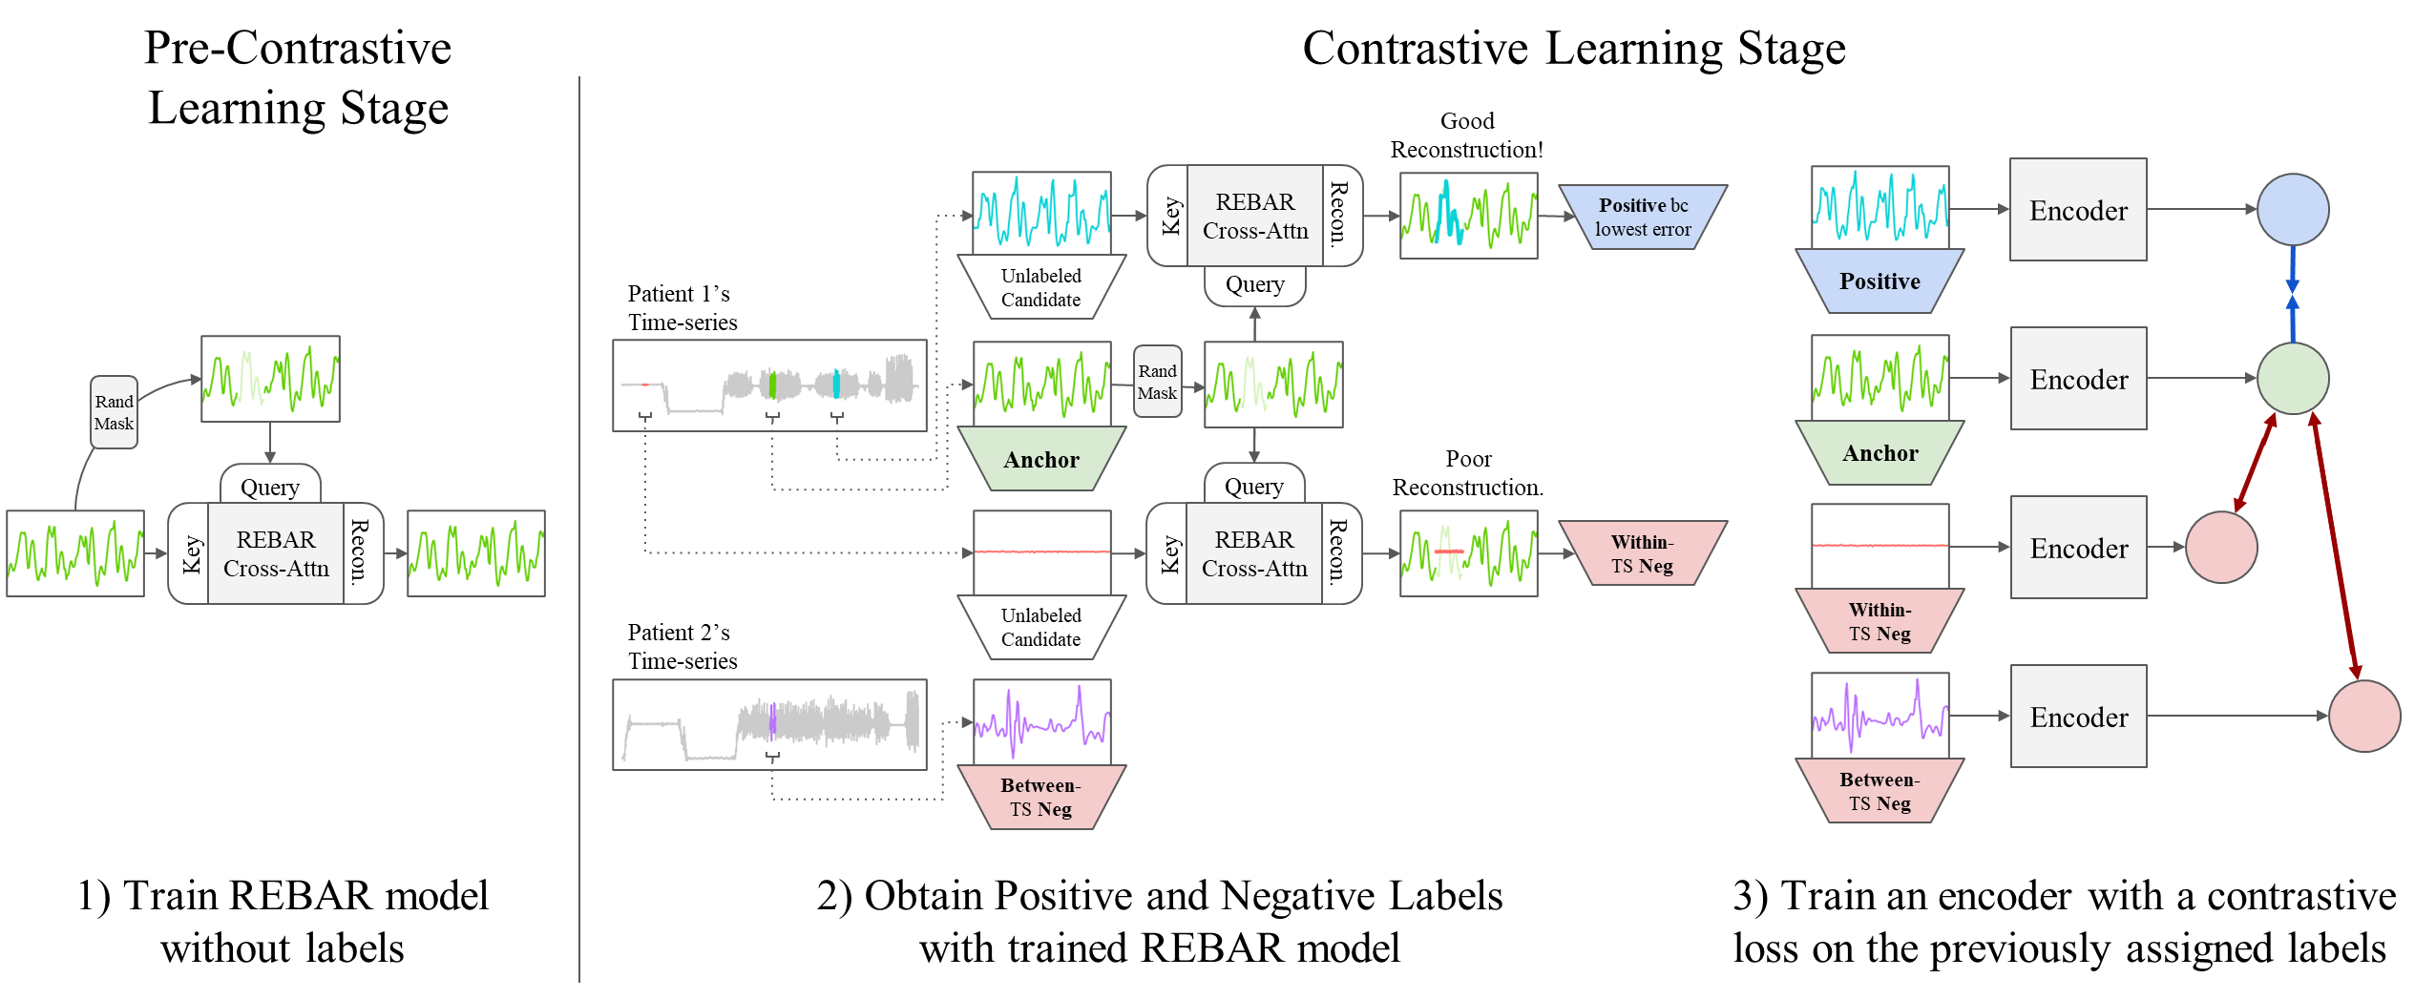
Conclusion
This is the first work to use a similarity measure to select positive and negative pairs in time-series contrastive learning
We demonstrate that our learned measure predicts mutual class membership
Our REBAR contrastive learning approach achieves SOTA performance
Notes:
In summary, This is the first work to use a similarity measure to select positive and negative pairs in time-series contrastive learning, and we achieve state-of-the-art performance.
Our REBAR method offers a powerful new perspective on how to identify positive pairings in time-series contrastive learning, and we hope that this work will drive future research into understanding how to best learn representations in time-series and the greater contrastive learning space.

Slide 27
Downstream Linear Probe Results
Notes:
In our downstream evaluation, the model architecture constant across all methods, with the only difference between them being the different ways in which positive pairs are chosen. And with this, we see that REBAR consistently achieved the strongest results, beating a wide range of representative augmentation-based and sampling-based contrastive methods, even beating a fully-supervised approach.

Slide 28
Downstream Clustering Results
Clusterability results demonstrate that REBAR has a strong agreement between k-mean clusters and true labels, corroborating classification results.
In the t-SNE visualization, unlike most methods, REBAR is able to distinguish between the walk, walk up, and walk down labels.
Notes:
WE follow this up with clusterability evaluations, and REBAR continues to have the strongest results. Very interestingly, we can see in our T-SNE visaualization, unlike most methods, REBAR is able to distnguish between semantically similar, but distinct classes,

